Slide 1
Mensuration

Slide 2
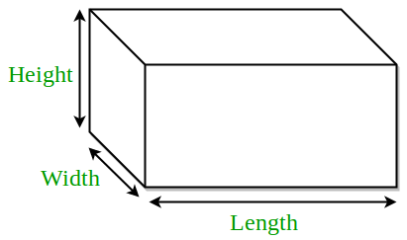
3D Figures:
Cuboid
Let
l= length
b= breadth
h= height. Then,
Volume = (l x b x h) cubic units.
Lateral Surface area = 2( b + l) h sq. units.
Surface area = 2(lb + bh + lh) sq. units.
Diagonal = √(l² + b² + h² ) units.

Slide 3
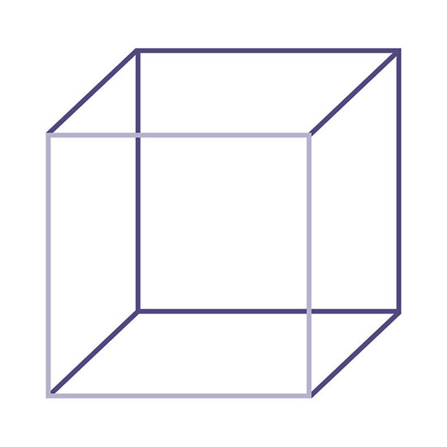
Cube
a
a
Let each edge of a cube be of length a. Then,
Volume = a³ cubic units.
Lateral Surface area = 4a² sq. units
Surface area = 6a² sq. units.
Diagonal = √3a units.
a

Slide 4
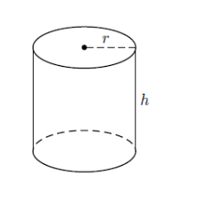
Cylinder
Let radius of base = r and Height (or length) = h. Then,
Volume = (пr²h) cubic units.
Curved surface area = (2пr h) sq. units.
Total surface area = 2 п r(h + r) sq. units.

Slide 5
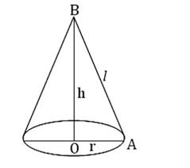
Cone
Let radius of base = r and Height = h. Then,
Slant height, l = √h² + r² units.
Volume = (1/3) п r²h cubic units.
Curved surface area = (п rl) sq. units.
Total surface area = (п rl + п r²) sq. units.

Slide 6
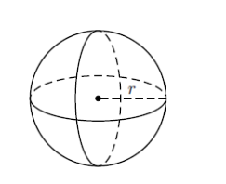
Sphere
Let the radius of the sphere be r. Then,
Volume = (4/3) п r³ cubic units.
Surface area = (4 п r²) sq. units.

Slide 7
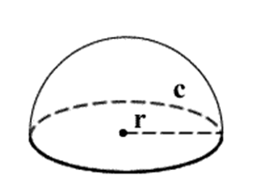
Hemisphere
Let the radius of a hemisphere be r. Then,
Volume = (2/3) п r³ cubic units.
Curved surface area = (2 п r²) sq. units.
Total surface area = (3 п r²) sq. units.

Slide 8
Practice Questions

Slide 9
1. If the areas of the three adjacent faces of a cubical box are 120 cm square, 72 cm square and 60 cm square respectively, then the volume of the box is:
A. 800 cm cube
B. 680 cm cube
C. 700 cm cube
D. 720 cm cube

Slide 10
1. If the areas of the three adjacent faces of a cubical box are 120 cm square, 72 cm square and 60 cm square respectively, then the volume of the box is:
A. 800 cm cube
B. 680 cm cube
C. 700 cm cube
D. 720 cm cube

Slide 11
2. A wooden box measures 20 cm × 12 cm × 10 cm. the thickness of the wood is 1 cm. The volume of the wood required to make the box is:
A. 960 cm cube
B. 900 cm cube
C. 1000 cm cube
D. 1100 cm cube

Slide 12
2. A wooden box measures 20 cm × 12 cm × 10 cm. the thickness of the wood is 1 cm. The volume of the wood required to make the box is:
A. 960 cm cube
B. 900 cm cube
C. 1000 cm cube
D. 1100 cm cube

Slide 13
3. The size of a wooden block is (15 cm × 12 cm × 20 cm). How many such blocks will be required to construct a solid wooden cube of minimum size?
A. 50
B. 40
C. 60
D. 55

Slide 14
3. The size of a wooden block is (15 cm × 12 cm × 20 cm). How many such blocks will be required to construct a solid wooden cube of minimum size?
A. 50
B. 40
C. 60
D. 55

Slide 15
4. Two solid cylinders of radii 4 cm and 5 cm and lengths 6 cm and 4 cm, respectively are recast into cylindrical disc of thickness 1 cm. The radius of the disc is
A. 7 cm
B. 14 cm
C. 21 cm
D. 28 cm

Slide 16
4. Two solid cylinders of radii 4 cm and 5 cm and lengths 6 cm and 4 cm, respectively are recast into cylindrical disc of thickness 1 cm. The radius of the disc is
A. 7 cm
B. 14 cm
C. 21 cm
D. 28 cm

Slide 17
5. The radius of cross-section of a solid cylindrical rod of iron is 50 cm. The cylinder is melted down and formed into 6 solid spherical balls of the same radius as that of the cylinder. The length of the rod (in m) is
A. 0.8
B. 2
C. 3
D. 4

Slide 18
5. The radius of cross-section of a solid cylindrical rod of iron is 50 cm. The cylinder is melted down and formed into 6 solid spherical balls of the same radius as that of the cylinder. The length of the rod (in m) is
A. 0.8
B. 2
C. 3
D. 4

Slide 19
6. A cone, a hemisphere and a cylinder stand on equal bases of radius R and have equal heights H. Their whole surface area are in the ratio:
A. (√3+1) : 3 : 4
B. (√2+1) : 7 : 8
C. (√2+1) : 3 : 4
D. None of these

Slide 20
6. A cone, a hemisphere and a cylinder stand on equal bases of radius R and have equal heights H. Their whole surface area are in the ratio:
A. (√3+1) : 3 : 4
B. (√2+1) : 7 : 8
C. (√2+1) : 3 : 4
D. None of these

Slide 21
8. A hemispherical basin 150 cm in diameter holds water one hundred and twenty times as much a cylindrical tube. If the height of the tube is 15 cm, then the diameter of the tube (in cm) is:
A. 23
B. 24
C. 25
D. 26

Slide 22
8. A hemispherical basin 150 cm in diameter holds water one hundred and twenty times as much a cylindrical tube. If the height of the tube is 15 cm, then the diameter of the tube (in cm) is:
A. 23
B. 24
C. 25
D. 26

Slide 23
9. A cylinder is circumscribed about a hemisphere and a cone is inscribed in the cylinder so as to have its vertex at the Centre of one end and the other end as its base. The volumes of the cylinder, hemisphere and the cone are respectively in the ratio of:
A. 3 : √3 : 2
B. 3 : 2 : 1
C. 1 : 2 : 3
D. 2 : 3 : 1

Slide 24
9. A cylinder is circumscribed about a hemisphere and a cone is inscribed in the cylinder so as to have its vertex at the Centre of one end and the other end as its base. The volumes of the cylinder, hemisphere and the cone are respectively in the ratio of:
A. 3 : √3 : 2
B. 3 : 2 : 1
C. 1 : 2 : 3
D. 2 : 3 : 1

Slide 25
10. The height of a cone is 40 cm. The cone is cut parallel to its base such that the volume of the small cone is 1/64 of the cone. Find at which height from base the cone is cut?
A. 20 cm
B. 30 cm
C. 25 cm
D. 22.5 cm

Slide 26
10. The height of a cone is 40 cm. The cone is cut parallel to its base such that the volume of the small cone is 1/64 of the cone. Find at which height from base the cone is cut?
A. 20 cm
B. 30 cm
C. 25 cm
D. 22.5 cm

Slide 27
11. A metallic hemisphere is melted and recast in the shape of cone with the same base radius 4 cm as that of the hemisphere. Find the height of the cone?
A. 5
B. 6
C. 8
D. 10
Notes:
Option C
(Compulsory)
(Moderate)
Sol: vol of hemisphere= vol of cone
2/3πr^3=1/3πr^2*h
H=8

Slide 28
11. A metallic hemisphere is melted and recast in the shape of cone with the same base radius 4 cm as that of the hemisphere. Find the height of the cone?
A. 5
B. 6
C. 8
D. 10
Notes:
Option C
(Compulsory)
(Moderate)
Sol: vol of hemisphere= vol of cone
2/3πr^3=1/3πr^2*h
H=8

Slide 29
12. If the radius of the sphere is increased by 4 cm, its surface area increased by 1408 cm². The radius of the sphere before change is :
A. 12
B. 9
C. 8
D. 5
Notes:
Option A
(Optional)
(Moderate)
Sol: difference of SA= 1408= 4π(r+4)^2-4πr^2
R=12

Slide 30
12. If the radius of the sphere is increased by 4 cm, its surface area increased by 1408 cm². The radius of the sphere before change is :
A. 12
B. 9
C. 8
D. 5
Notes:
Option A
(Optional)
(Moderate)
Sol: difference of SA= 1408= 4π(r+4)^2-4πr^2
R=12

Slide 31
13. The height of a conical tank is 12 cm and the diameter of its base is 32 cm. The cost of painting if from outside at the rate of Rs. 35 per sq. cm. is?
A. 53420
B. 45260
C. 35200
D. 26500
Notes:
Option C
(Compulsory)
(Moderate)
Sol: Slant height 𝑙^2=〖12〗^2+〖16〗^2
L=20
Total cost= CSA*35= 22/7*16*20*35=35200

Slide 32
13. The height of a conical tank is 12 cm and the diameter of its base is 32 cm. The cost of painting if from outside at the rate of Rs. 35 per sq. cm. is?
A. 53420
B. 45260
C. 35200
D. 26500
Notes:
Option C
(Compulsory)
(Moderate)
Sol: Slant height 𝑙^2=〖12〗^2+〖16〗^2
L=20
Total cost= CSA*35= 22/7*16*20*35=35200

Slide 33
14. The total surface area of a metallic hemisphere is 462 cm². A solid right circular cone is formed after melting the hemisphere. If the radius of the base of the cone is same as the radius of the hemisphere its height is?
A. 12
B. 14
C. 16
D. 18
Notes:
Option B
(Compulsory)
(Moderate)
Sol: TSA of hemisphere=462=3πr^2
r= 7 cm
when Vol of hemisphere = vol of cone, then
H=2r=14

Slide 34
15. Balls of the marbles of diameter 1.4 cm diameter are dropped into a cylindrical beaker containing some water and fully submerged. The diameter of the beaker is 14 cm. Find how many marbles have been dropped in it if the water rises by 5.6 cm?
A. 525
B. 575
C. 600
D. 625
Notes:
Option C
(Optional)
(Moderate)
Sol: n= vol of cylinder/vol of a marble
n= 600

Slide 35
16. By melting a solid lead sphere of radius 6 cm, three small spheres are made whose radii are in ratio 3:4:5. The radius of the smallest sphere is?
A. 3
B. 4
C. 5
D. 6
Notes:
Option A
(Optional)
(Moderate)
Volume of big solid lead sphere = 288π cubic cm
Given,
Radius of three small spheres are 3A, 4A, 5A respectively.
Given,
⇒ 288π = (4/3) × π × [(3A)³ + (4A)³ + (5A)³]
⇒ 216 = 216A³
⇒ A = 1
Radius of circle = 3 cm, 4 cm, 5 cm
∴ Radius of smallest sphere is 3 cm.

Slide 36
17. Find the number of bricks, each measuring 30 cm x 10 cm x 8 cm, required to construct a wall 24 m long, 8 m high and 60 cm thick, if 10% of the wall is filled with mortar?
A. 35000
B. 43200
C. 55600
D. 65800
Notes:
Option B
(Compulsory)
(Moderate)
Sol: Vol of wall= 24*8*60/100
10% mortar therefore 90% brick
Now,
24*8*60*100*90/100=n*30/100*10/100*8/100
n= 43200

Slide 37
18. A large cube is formed from the material obtained by melting three smaller cubes of 3, 4 and 5 cm side. What is the ratio of the total surface areas of the smaller cubes and the large cube?
A. 15: 9
B. 18: 15
C. 20: 27
D. 25: 18
Notes:
Option D
(Optional)
(Moderate)
Sol: Volume of larger cube-= sum of all other cubes
𝑎^3=27+64+125
a= 6
TSA of large cube: TSA of small cubes
6*6^2: 6(9+16+25)
18:25

Slide 38
19. A hollow iron pipe is 21 cm long and its external diameter is 8 cm. If the thickness of the pipe is 1 cm and iron weighs 8g/cu.cm, then the weight of the pipe is?
A. 3.6 kg
B. 36 kg
C. 3.696 kg
D. 36.9 kg
Notes:
Option C
(Compulsory)
(Moderate)
Volume of iron =π(R2−r2)×h
=π(42−32)×21
=722​×(16−9)×21
=462cm2
Weight =10008×462​kg=3.696kg

Slide 39
7. A large solid sphere of diameter 15 m is melted and recast into several small spheres of diameter 3 m. What is the percentage increase in the surface area of the smaller spheres over that of the large sphere?
A. 200%
B. 400%
C. 500%
D. can’t be determined

Slide 40
20. If the height of a given cone be doubled and radius of the base becomes half, the ratio of the volume of the given cone to that of the second cone will be?
A. 2:3
B. 1:8
C. 3:2
D. None of these
Notes:
Option D
(Optional)
(Moderate)
Sol: 1/3πr^2*h :1/3π*𝑟^2/4*2h
2:1

Slide 41
21. The numerical values of the volume and the area of the lateral surface of a right circular cone are equal. If the height of the cone be h and radius be r, the value of r²h²/(r²+h²)is?
A. 1/9
B. 1/3
C. 3/1
D. 9/1
Notes:
Option D
(Compulsory)
(Moderate)
Sol: The numerical values of the volume and the area of the lateral surface of a right circular cone are equal, which gives the relation-> rh/3=l
rh/3=(ℎ^2+𝑟^2 )^(1/2)
Squaring on both sides
r²h²/(r²+h²)=9

Slide 42
22. A sphere of radius ‘r’ is cut on a plane at the distance of ‘h’ from its center, thereby breaking this sphere into two different pieces. The cumulative surface area of these two pieces is 25% more than that of the sphere. Find ‘h’.
A. r/(√3)
B. r/(√2)
C. r/(√6)
D. r/(√5)
Notes:
Option B
(Optional)
(Moderate)
Sol: Area of pieces= 1.25*4π𝑟^2 =5π𝑟^2
Extra area= π𝑟^2
Therefore, area of each new circle= π𝑟^2/2
Let the radius of new circle = r1
π𝑟1^2="πr^2/2"
r1=r/√2
Now,
𝑟1^2+ℎ^2=𝑟^2
H=r/√2

Slide 43
23. The total surface area of a solid cylinder is 462 cm². The area of the curved surface is 1/3 of the total surface area. The volume of cylinder is?
A. 530 cm²
B. 536 cm²
C. 539 cm²
D. 545 cm²
Notes:
Option C
(Optional)
(Moderate)
Sol: 2πrh= 1/3*2πr(r+h)
2h=r
Now, TSA=462=2πr(r+h)
h=7/2
Therefore, r=7
Volume=22/7*7*7*7/2=539

Slide 44
24. The radii of bases, as well as the height of a cylinder and a cone, are equal. If their curved surfaces areas are in the ratio of 24 : 13, the ratio of their radii and heights is?
A. 4: 9
B. 9: 4
C. 12: 5
D. 5: 12
Notes:
Option D
(Optional)
(Moderate)
Sol: (𝐶𝑆𝐴 𝑜𝑓 𝑐𝑦𝑙𝑖𝑛𝑑𝑒𝑟)/(𝐶𝑆𝐴 𝑜𝑓 𝑐𝑜𝑛𝑒)=24/13
Solve the equation for r/h
ans= 5/12

Slide 45
25. An inverted right circular cone has a radius of 9 cm. This cone is partly filled with oil which is dipping from a hole in the tip at a rate of 1cm³/hour. Currently the level of oil 3 cm from top and surface area is 49π cm². How long will it take the cone to be completely empty?
A. 72π hours
B. 1 hour
C. 343π/2 hours
D. 98π hours
Notes:
Option C
(Compulsory)
(Moderate)
Sol: SA of oil = 49π=π𝑟^2
r=7
Height of the oil h= 21/2
Vol of oil in the cone= 1/3*π*𝑟^2∗ℎ = 343/2*π
Therefore, time = 343/2*π hours

Slide 46


